Slide 1

Cancer prediction in early stage
By
BINUSHA S
960521104016

Slide 2
What is cancer?
Definition
a term used for diseases in which abnormal cells divide without control and are able to invade other tissues
Cancer cells spread to other parts of the body through the blood and lymph systems
Cancer is not just one disease but many diseases
More than 100 different types of cancer
Source: National Cancer Institute

Slide 3
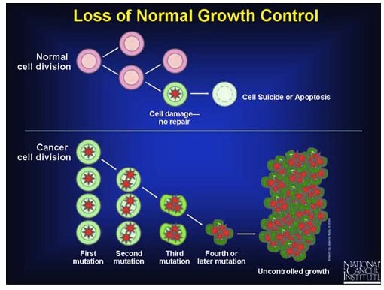
Notes:
The body is made up of many types of cells. These cells grow and divide in a controlled way to produce more cells as they are needed to keep the body healthy. When cells become old or damaged, they die and are replaced with new cells.
However, sometimes this orderly process goes wrong. The genetic material (DNA) of a cell can become damaged or changed, producing mutations that affect normal cell growth and division. When this happens, cells do not die when they should and new cells form when the body does not need them. The extra cells may form a mass of tissue called a tumor.

Slide 4
Main Categories
Carcinoma - cancer that begins in the skin or in tissues that line or cover internal organs. There are a number of subtypes of carcinoma: adenocarcinoma, basal cell carcinoma, squamous cell carcinoma,transitional cell carcinoma.
Sarcoma - cancer that begins in bone, cartilage, fat, muscle, blood vessels, or other connective or supportive tissue.
Leukemia - cancer that starts in blood-forming tissue such as the bone marrow and causes large numbers of abnormal blood cells to be produced and enter the blood.
Lymphoma and myeloma - cancers that begin in the cells of the immune system.
Central nervous system cancers - cancers that begin in the tissues of the brain and spinal cord.
Notes:
Most cancers are named for the organ or type of cell in which they start - for example, cancer that begins in the colon is called colon cancer; cancer that begins in melanocytes of the skin is called melanoma.

Slide 5
Causes
Cigarette smoking
Poor diet
Physical inactivity
Occupational exposures
Viruses and other biological agents
Reproductive factors
Alcohol
Cancer
Consequences
High health care costs for treatment
Lost work productivity
Insurance denial
Disability
Psychosocial problems
Treatment complications (eg. Increased risk of second cancers)
Premature mortality
High risk populations
Poor
Less educated
Racial and ethnic minorities
Persons with a family history of cancer
Elderly
Cancer: causes, consequences, and high-risk populations
Source: Chronic disease epidemiology and control

Slide 6
Cancer staging
Based on the size or extent of the primary (main) tumor and whether it has spread to other areas of the body.
Summary staging (in situ, local, regional, and distant) is used for descriptive and statistical analysis of tumor registry data.
Cancer cells are present only in the layer of cells where they developed and have not spread, the stage is in situ.
If penetrated beyond the original layer of tissue, the cancer is invasive and categorized as local, regional, or distant stage based on the extent of spread

Slide 7
TNM staging
Assesses tumors in three ways:
extent of the primary tumor (T)
Absence or presence of regional lymph node involvement (N)
Absence or presence of distant metastases (M).
Once the T, N, and M categories are determined, a stage of 0, I, II, III, or IV is assigned,
stage 0 - in situ,
stage I - early
stage IV - the most advanced disease.
Some cancers have alternative staging systems (e.g., leukemia).

Slide 8
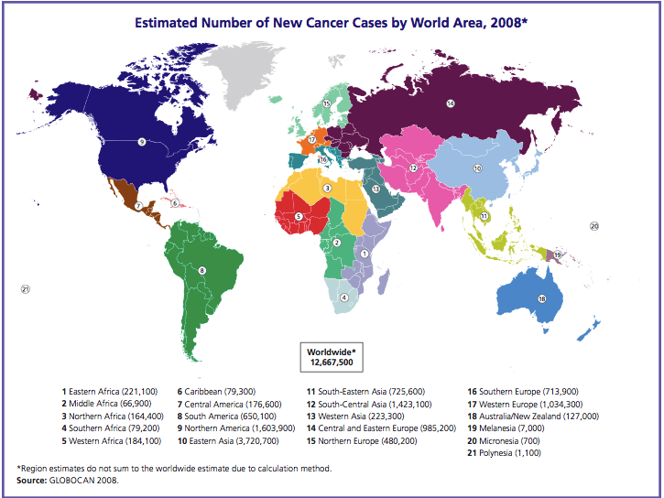
Notes:
Global Cancer Facts & Figures: 2nd Edition

Slide 9
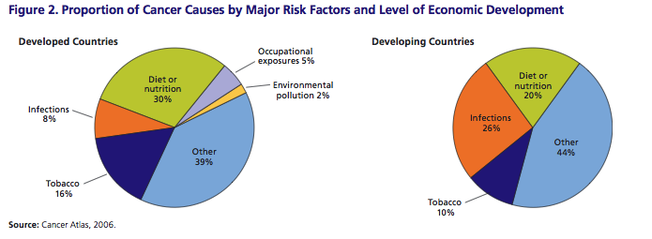

Slide 10
Facts
Mortality
In 2014, about 585,720 Americans are expected to die of cancer (almost 1,600 people/day)
Cancer: second most common cause of death in the US, exceeded only by heart disease
Survival
5-year relative survival rate for all cancers diagnosed between 2003 and 2009 is 68%, up from 49% in 1975-1977
improvement in survival reflects both progress in diagnosing certain cancers at an earlier stage and improvements in treatment
Survival statistics vary greatly by cancer type and stage at diagnosis.
Source: American Cancer Society- Cancer Facts and Figures 2013

Slide 11
New cancer cases
2010: more than one-half of all new cancers-cancers of the prostate, female breast, lung, and colon/rectum.
American Cancer Society projections:
1,529,560 new cases of cancer in 2010
222,520 cases of lung cancer
217,730 cases of prostate cancer
209,060 cases of female breast cancer
142,570 cases of colon/rectum cancer
Source: National Cancer Institute, Cancer Trends Progress Report 2011/2012 update

Slide 12
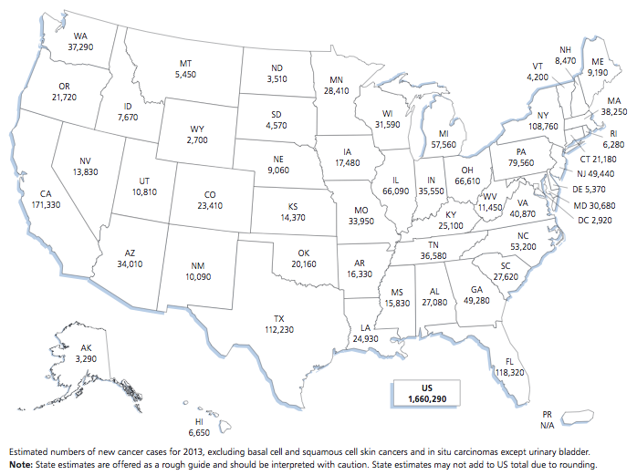

Slide 13

All Cancers Combined Incidence Rates* by State, 2010

Slide 14
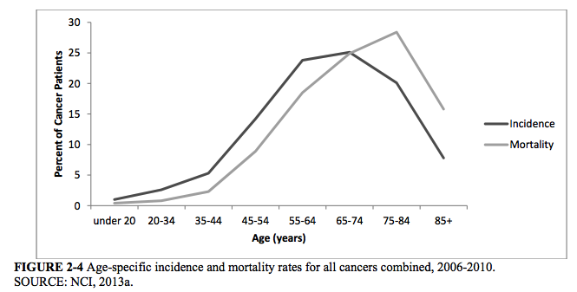
Notes:
Delivering High-Quality Cancer Care: Charting a New Course for a System in Crisis

Slide 15
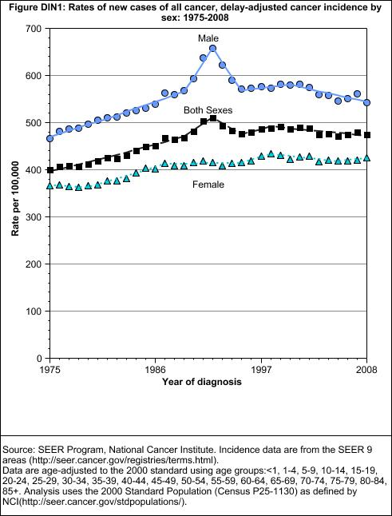
Notes:
Source: National Cancer Institute, Cancer Trends Progress Report 2011/2012 update

Slide 16
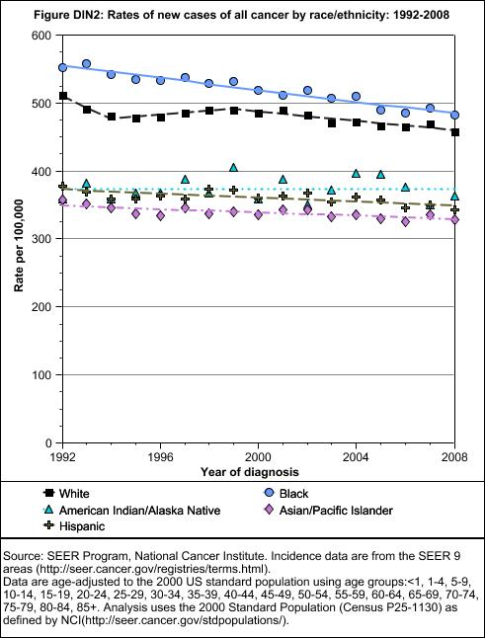
Notes:
Source: National Cancer Institute, Cancer Trends Progress Report 2011/2012 update

Slide 17
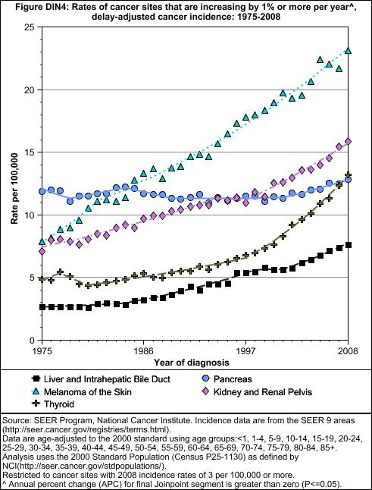
Notes:
Source: National Cancer Institute, Cancer Trends Progress Report 2011/2012 update

Slide 18
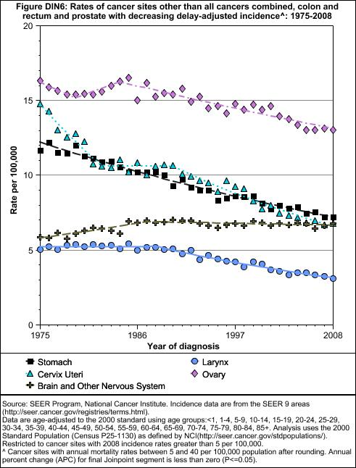
Notes:
Source: National Cancer Institute, Cancer Trends Progress Report 2011/2012 update

Slide 19
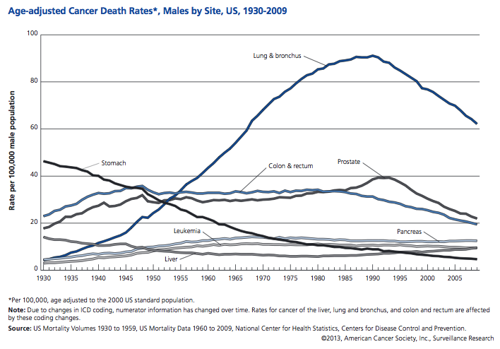

Slide 20
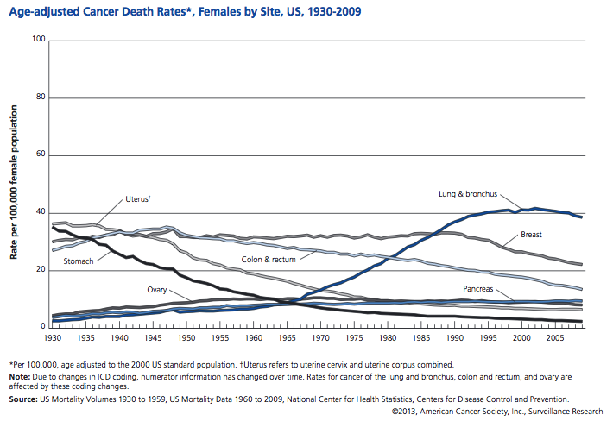

Slide 21
Treatment
Types: Surgery, chemotherapy, radiation therapy, targeted therapy, immunotherapy, hyperthermia, stem cell transplant, photodynamic therapy, lasers, blood product donation and transfusion
Complementary and Alternative Medicine: dietary supplements; mind, body and spirit; herbs, vitamins and minerals
Palliative or Supportive Care: focuses on helping patients get relief from symptoms caused by serious illness – things like nausea, pain, fatigue, or shortness of breath

Slide 22
Side Effects
Physical: Chemotherapy/Radiation effects; pain; nausea & vomiting; fatigue; anemia; lymphedema; infection; fertility and sexual side effects
Emotional: distress, anxiety, fear and depression, coping with loss of a loved one
Source: American Cancer Society: http://www.cancer.org/treatment/treatmentsandsideeffects/emotionalsideeffects/attitudes-and-cancer

Slide 23
Costs of cancer
Hidden costs of cancer: health insurance premiums and nonmedical expenses (transportation, child or elder care, housekeeping assistance, wigs, etc.)
Cancer has the most devastating economic impact of any cause of death in the world
Worldwide economic costs of cancer: $895 billion (US)
Cancer cost the United States an estimated $263.8 billion in medical costs and lost productivity in 2010 (National Institutes of Health)
With the growth and aging of the population, prevention efforts are important to help reduce new cancer cases, human suffering, and economic costs
Source: ACS: Global cancer facts & figures 2nd edition

Slide 24
The costs of direct medical care for cancer: estimated to account for 5% of national health care spending
UnitedHealthcare, estimated that 11 percent of its costs are for cancer care (IOM, 2013).
National expenditures for cancer care
$72 billion in 2004
$125 billion in 2010
Estimated to increase to $158 billion in 2020

Slide 25
ACA
Expand public coverage by removing the Medicaid eligibility categories and raising the income threshold.
Allow all non-elderly, non-disabled citizens, and legal U.S. residents with family incomes below 133 percent of the federal poverty level (FPL), or about $30,000 per year for a family of four, to be eligible for Medicaid benefits.
Extends coverage to low-income, childless adults, providing them with access to preventive care such as colon and breast cancer screenings
Anticipated that more people with cancer can be diagnosed and treated at an earlier stage, thus increasing their chance for survival.

Slide 26
Effective Cancer Prevention
Reduced risk by:_
avoiding tobacco
limiting alcohol use
limiting exposure to ultraviolet rays from the sun and tanning beds
eating a diet rich in fruits and vegetables
maintaining a healthy weight
being physically active
seeking regular medical care
Screening: cervical, breast and colorectal cancers
Vaccine: HPV, Hepatitis B
Source: CDC

Slide 27
Guidelines for the Early Detection of Cancer
Breast cancer
Yearly mammograms starting at age 40 and continuing for as long as a woman is in good health
Clinical breast exam (CBE) about every 3 years for women in their 20s and 30s and every year for women 40 and over
Breast self-exam (BSE) is an option for women starting in their 20s

Slide 28
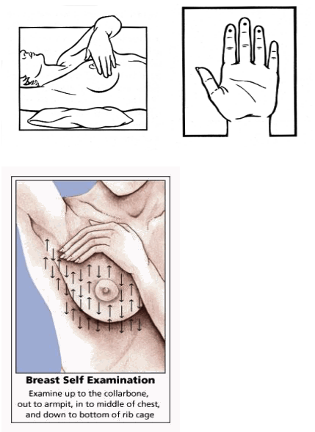

Slide 29
Colorectal cancer and polyps
Beginning at age 50, both men and women should follow one of these testing schedules:
Tests that find polyps and cancer
Flexible sigmoidoscopy every 5 years
Colonoscopy every 10 years
Double-contrast barium enema every 5 years
CT colonography (virtual colonoscopy) every 5 years
Tests that primarily find cancer
Yearly fecal occult blood test (gFOBT)
Yearly fecal immunochemical test (FIT) every year
Stool DNA test (sDNA)***

Slide 30
Lung cancer
If you meet all of the following criteria, might be a candidate for screening:
55 to 74 years of age
In fairly good health
Have at least a 30 pack-year smoking history AND are either still smoking or have quit smoking within the last 15 years

Slide 31
Prostate cancer
Starting at age 50, men should talk to a doctor about the pros and cons of testing so they can decide if testing is the right choice for them.
If they are African American or have a father or brother who had prostate cancer before age 65, men should have this talk with a doctor starting at age 45.
If men decide to be tested, they should have the PSA blood test with or without a rectal exam.
How often they are tested will depend on their PSA level.
Notes:
Prostate-specific antigen

Slide 32
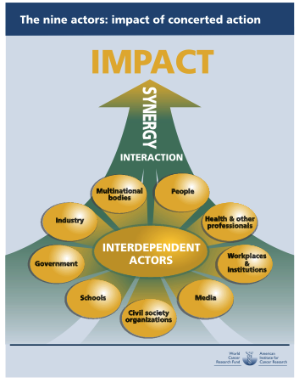
Notes:
Policy and action for cancer prevention: World Cancer Research Fund and American Institute for Cancer Research

Slide 33
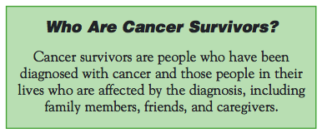

Slide 34
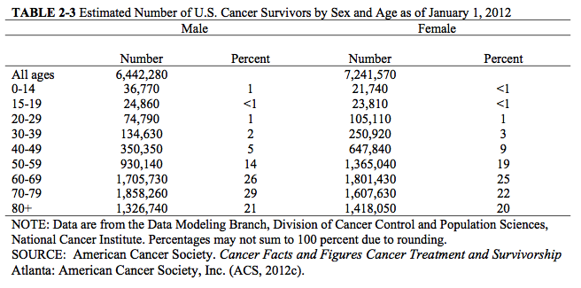

Slide 35
A National Action Plan for Cancer Survivorship
Achieve the cancer survivorship-related objectives in Healthy People 2010 that include benchmarks for success in measuring improvements for addressing ongoing survivor needs.
Increase awareness among the general public, policy makers, survivors, providers, and others of cancer survivorship and its impact.
Establish a solid base of applied research and scientific knowledge on the ongoing physical, psychological, social, spiritual, and economic issues facing cancer survivors.
Identify appropriate mechanisms and resources for ongoing surveillance of people living with, through, and beyond cancer.
Establish or maintain training for health care professionals to improve delivery of services and increase awareness of issues faced by cancer survivors.
Implement effective and proven programs and policies to address cancer survivorship more comprehensively.
Ensure that all cancer survivors have adequate access to high-quality treatment and other post-treatment follow-up services.
Implement an evaluation methodology that will monitor quality and effectiveness of the outcomes of initiatives.
Notes:
Source: A National Action Plan for Cancer Survivorship: Advancing Public Health Strategies

Slide 36
Translational Researches
Intervention Research: Accelerating the Translation of Knowledge to Improve Cancer Related Fatigue Outcomes
The Reflected Light of Steve Jobs: A Brighter Future for Pancreatic Cancer
Viruses, Bacteria, and Cancer, or It’s Not All Smoke and Sunlight

